Slide 1
Professional JavaScript for
Web Development
Chapter-11 : DOM Extensions
PRESENTED BY:
DAW SAW THANDAR SHWE
LECTURER
ITSM DEPARTMENT
UNIVERSITY OF COMPUTER STUDIES (SITTWAY)
Information Technology Supporting and Maintenance

Slide 2
Outline
querySelector()
qureySelectorAll()
Classist Property
Markup Insertion
Information Technology Supporting and Maintenance

Slide 3
The querySelector () method
accepts a CSS query
returns the first descendant element that matches the pattern
returns null if there is no matching element
is available on the Document type and on the Element type
Document type:
Element type:
document . querySelector ( CSS_Selector );
Element . querySelector (CSS_Selector );
Information Technology Supporting and Maintenance

Slide 4
The querySelector () method (Cont’d)
<html>
<head>
<script type=“text/javascript” src=“querySelect.js”>
</script>
</head>
<body>
<ul>
<li>First item</li>
<li class="selected">Second item</li>
<li>Third item</li>
</ul>
</body>
</html>
querySelect.js
  if (document.querySelector)
  {
  var body=document.querySelector("body");
  alert(body.tagName); //BODY
  var myDiv=document.querySelector("#myDiv")
  alert(myDiv); //null
  var selected=document.querySelector (".selected");
  alert(selected.innerHTML); //second item
  var img=document.body.querySelector("img.button"); alert(img); //null
  }
Information Technology Supporting and Maintenance

Slide 5
The querySelectorAll () method
accepts a CSS query
returns a NodeList object regardless of all matching nodes.
is available on the Document, DocumentFragment, and Element types
Document type:
DocumentFragment type:
Element type:
document . querySelectorAll ( CSS_Selector );
DocumentFragment . querySelectorAll ( CSS_Selector );
Element . querySelectorAll ( CSS_Selector );
Information Technology Supporting and Maintenance

Slide 6
The querySelectorAll () method (Cont’d)
<html>​
<body>​
<h2>JavaScript HTML DOM!</h2>​
<p>Hello World!</p>​
<p>Hello Norway!</p>​
<p id="demo"></p>​
<script>
var myNodelist = document.querySelectorAll("p");​
document.getElementById("demo").innerHTML =​"The innerHTML of the second paragraph is: “ + ​myNodelist[1].innerHTML;​
  alert(myNodelist.length);​
</script>
</body>
</html>
Information Technology Supporting and Maintenance

Slide 7
The matchesSelector () method
accepts CSS selector
returns true if the given element matches the selector or false if not.
is available on the Element type.
    if (document.body.matchesSelector(“body.page1”)){
    //To do something
    }
Element . matchesSelector ( CSS_Selector );
Information Technology Supporting and Maintenance

Slide 8
The matchesSelector () method (Cont’d)
<body class="page1">
<script type="text/javascript">
function matchesSelector(element, selector){
if (element.matchesSelector) {return element.matchesSelector(selector); }
else if (element.msMatchesSelector){ return element.msMatchesSelector(selector);}
else if (element.mozMatchesSelector){ return element.mozMatchesSelector(selector); }
else if (element.webkitMatchesSelector){ return element.webkitMatchesSelector(selector); }
else { throw new Error("Not supported."); }
}
if (matchesSelector(document.body, "body.page1")){
alert("It's page 1!"); }
</script>
</body>
Information Technology Supporting and Maintenance

Slide 9
HTML5
contains a large amount of JavaScript APIs designed for use with the markup additions.
this lecture focuses only on the parts that affect all DOM nodes
Information Technology Supporting and Maintenance

Slide 10
The getElementsByClassName () method
accepts one or more class names as an arguments
returns a NodeList containing all elements that have all of the specified classes applied
is available on the document object and on all HTML elements.
Example:
var allCurrentUsernames= document.getElementsByClassName(“username current”);
var selected= document.getElementById(“myDiv”).getElementsByClassName(“selected”);
Information Technology Supporting and Maintenance

Slide 11
The classList Property (1/5)
returns the class name(s) of an element.
is used to add, remove, and replace class names
is an instance of a new type of collection named DOMTokenList
Table 1. Methods of DOMTokenList collection.
Method | Description
add(value) | Adds the given string value to the list. If the value already exists, it will not be added.
contains(value) | Indicates if the given value exists in the list (true if so; false if not).
remove(value) | Removes the given string value from the list.
toggle(value) | If the value already exists in the list, it is removed. If the value doesn’t exist, then it’s added.
Information Technology Supporting and Maintenance

Slide 12
The classList Property (2/5)
<html>
<head><style> .mystyle {background-color: blue; color: white;} </style></head>
<body>
<p>Click the button to add the "mystyle" class to DIV.</p>
<button onclick=“myFunction()” >Try it</button>
<div id="myDIV">I am a DIV element</div>
<script>
  function myFunction() {
  document.getElementById("myDIV") . classList . add("mystyle");
  }
</script>
</body></html>
Information Technology Supporting and Maintenance

Slide 13
The classList Property (3/5)
<html>
<head>
<style> .mystyle {background-color: blue;color: white;}</style></head>
<body>
<p>Click the button to add the "mystyle" class to DIV.</p>
<button onclick="myFunction()">Try it</button>
<div id="myDIV" class="mystyle">I am a DIV element</div>
<script>
function myFunction() {
  document.getElementById("myDIV").classList.remove("mystyle");
  }
</script>
</body>
</html>
Information Technology Supporting and Maintenance

Slide 14
The classList Property (4/5)
<html>
<head><style>
  .mystyle {background-color: blue;color: white; width:200px;}
  .newClass{background-color:purple:color:blue:width:200px;text-align:center}
</style></head>
<body>
<p>Click the button to add the "mystyle" class to DIV.</p>
<button onclick="myFunction()">Try it</button>
<div id="myDIV" class="mystyle">am a DIV element</div>
<script>
function myFunction() {
  document.getElementById("myDIV").classList.toogle(“newClass");
  }
  </script></body></html>
Information Technology Supporting and Maintenance

Slide 15
The classList Property (5/5)
<html><head><style>
.firstClass { width: 500;height: 50px;border: 1px solid black;}
.secondClass { background-color: lightblue;padding: 25px;}
.thirdClass { text-align: center;font-size: 25px;color: pink;margin-bottom: 10px;}
</style></head>
<body>
<div id="myDIV" class="firstClass secondClass thirdClass">I am a DIV element</div>
<button onclick="myFunction()">Try it</button>
<p id="demo"></p>
<script>
  function myFunction() {
  var x = document.getElementById("myDIV").classList.contains("firstClass");
  document.getElementById("demo").innerHTML = x;}
</script></body></html>
Information Technology Supporting and Maintenance

Slide 16
The innerHTML Property (1/4)
In read mode, the property returns the HTML representing all of the child nodes.
Example:
  <body>
  <div id="content">
  <p>This is a <strong>paragraph</strong> with a list following it.</p>
  <ul>
  <li>Item 1</li><li>Item 2</li><li>Item 3</li>
  </ul></div>
  <input type="button" value="Get InnerHTML" onclick="getInnerHTML()">
  <script type="text/javascript">
  function getInnerHTML(){
  var div = document.getElementById("content");
  alert(div.innerHTML); }
  </script></body>
Information Technology Supporting and Maintenance

Slide 17
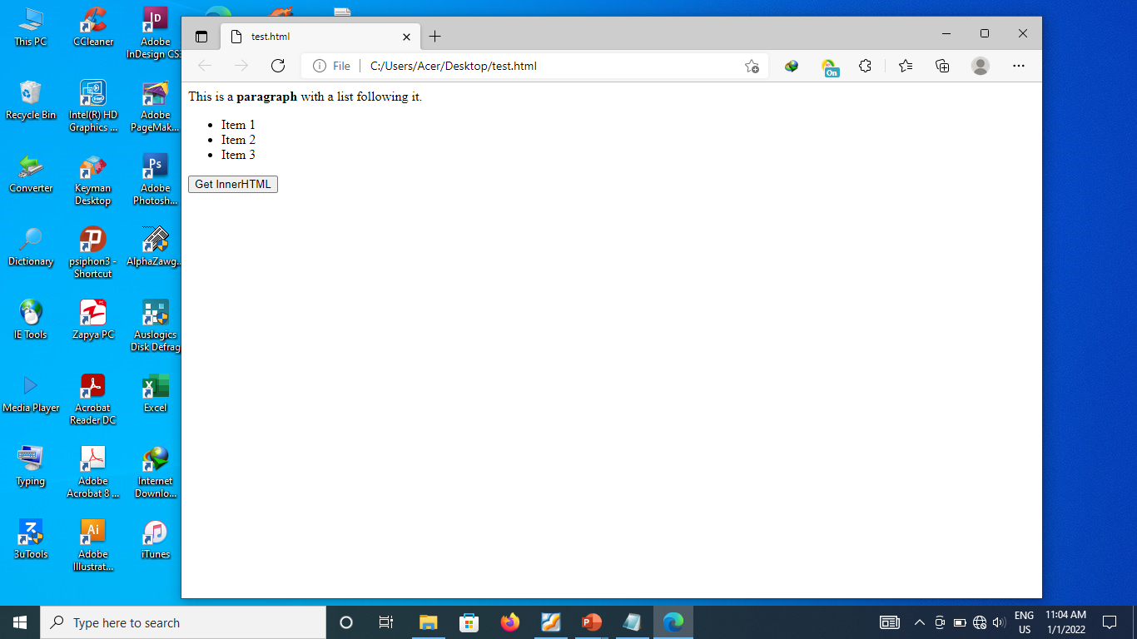
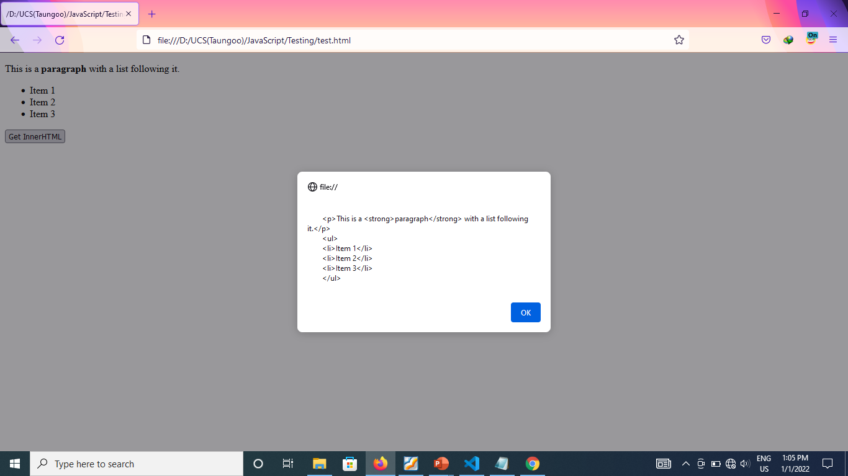
The innerHTML Property (2/4)
Information Technology Supporting and Maintenance

Slide 18
The innerHTML Property (3/4)
In write mode, the property parses the given string into a DOM subtree and replaces all of the existing child nodes with it.
Example:
<body>
<div id="content">
<p>This is a <strong>paragraph</strong> with a list following it.</p>
<ul> <li>Item 1</li> <li>Item 2</li> <li>Item 3</li> </ul>
</div>
<input type="button" value="Set InnerHTML" onclick="setInnerHTML()">
<script type="text/javascript">
  function setInnerHTML(){
  var div = document.getElementById("content");
  div.innerHTML = "Hello & welcome, <b>\"reader\"!</b>";
  } </script> </body>
Information Technology Supporting and Maintenance

Slide 19
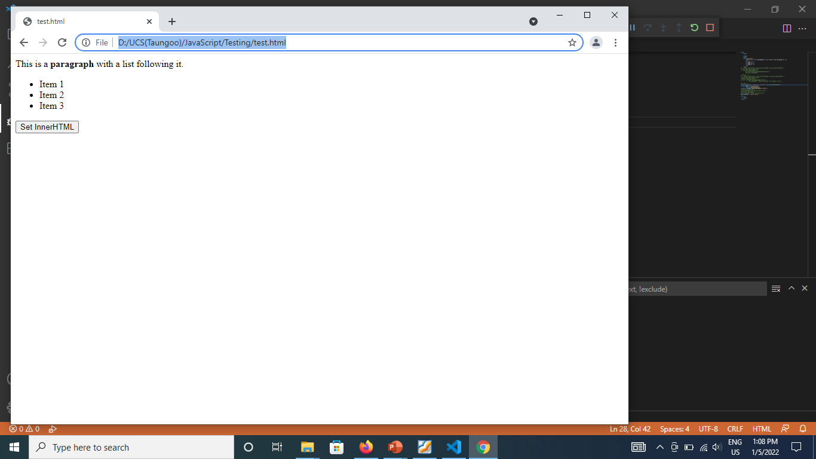
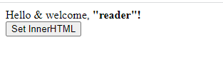
The innerHTML Property (4/4)
Information Technology Supporting and Maintenance

Slide 20
The outerHTML Property (1/3)
In read mode, the property returns the HTML of element on which it is called as well as its child nodes.
Example:
  <body>
  <div id="content">
  <p>This is a <strong>paragraph</strong> with a list following it.</p>
  <ul> <li>Item 1</li> <li>Item 2</li> <li>Item 3</li> </ul>
  </div>
  <input type="button" value="Get OuterHtml" onclick="getOuterHTML()">
  <script type="text/javascript">
  function getOuterHTML(){
      var div = document.getElementById("content");
      alert(div.outerHTML); //works in IE, Safari, and Opera
  } </script></body>
Information Technology Supporting and Maintenance

Slide 21
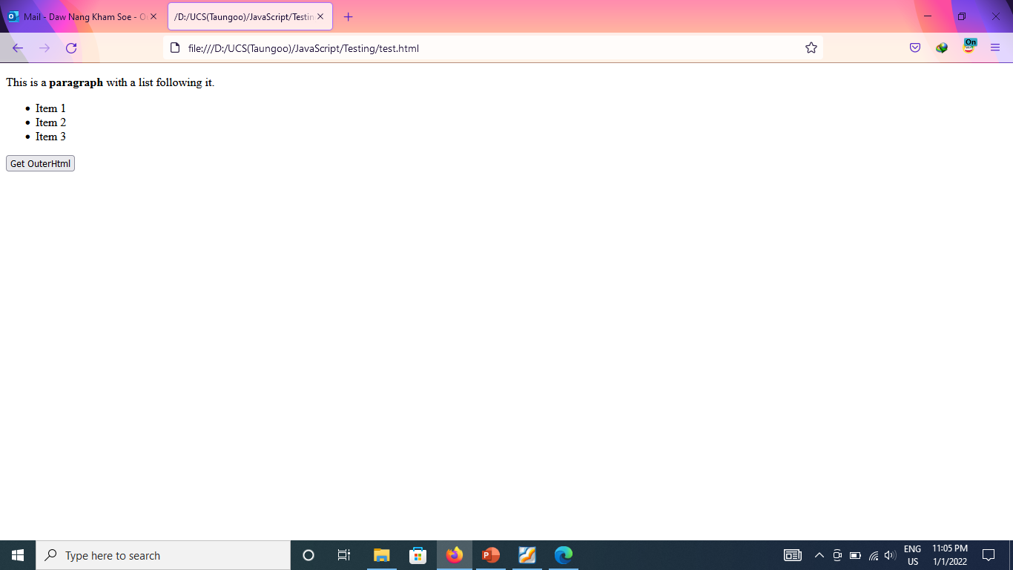
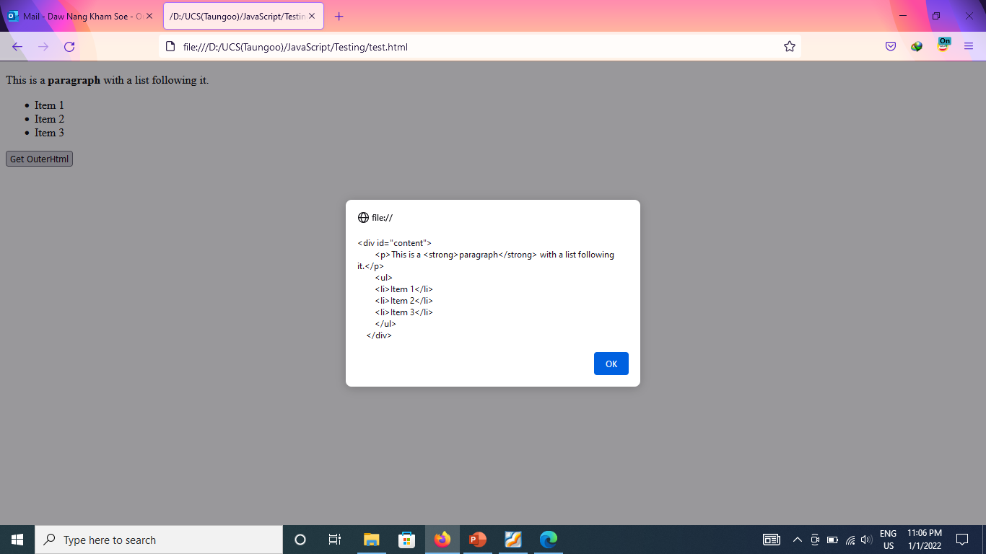
The outerHTML Property (2/3)
Information Technology Supporting and Maintenance

Slide 22
The outerHTML Property (3/3)
In write mode, the property replaces the node on which it called with the DOM subtree created from passing the given HTML string.
Example:
div.outerHTML=”<h1> Hello & World </h1>” //Hello & World
Information Technology Supporting and Maintenance

Slide 23
The innerText Property (1/4)
In read mode, the property concatenates the values of all text nodes in the subtree in depth-first order.
Example:
  <body>
  <div id="content">
  <p>This is a <strong>paragraph</strong> with a list following it.</p>
  <ul>
  <li>Item 1</li><li>Item 2</li><li>Item 3</li>
  </ul></div>
  <input type="button" value="Get InnerText" onclick="getInnerText()">
  <script type="text/javascript">
  function getInnerText(){
  var div = document.getElementById("content");
  alert(div.innerText); }
  </script></body>
Information Technology Supporting and Maintenance

Slide 24
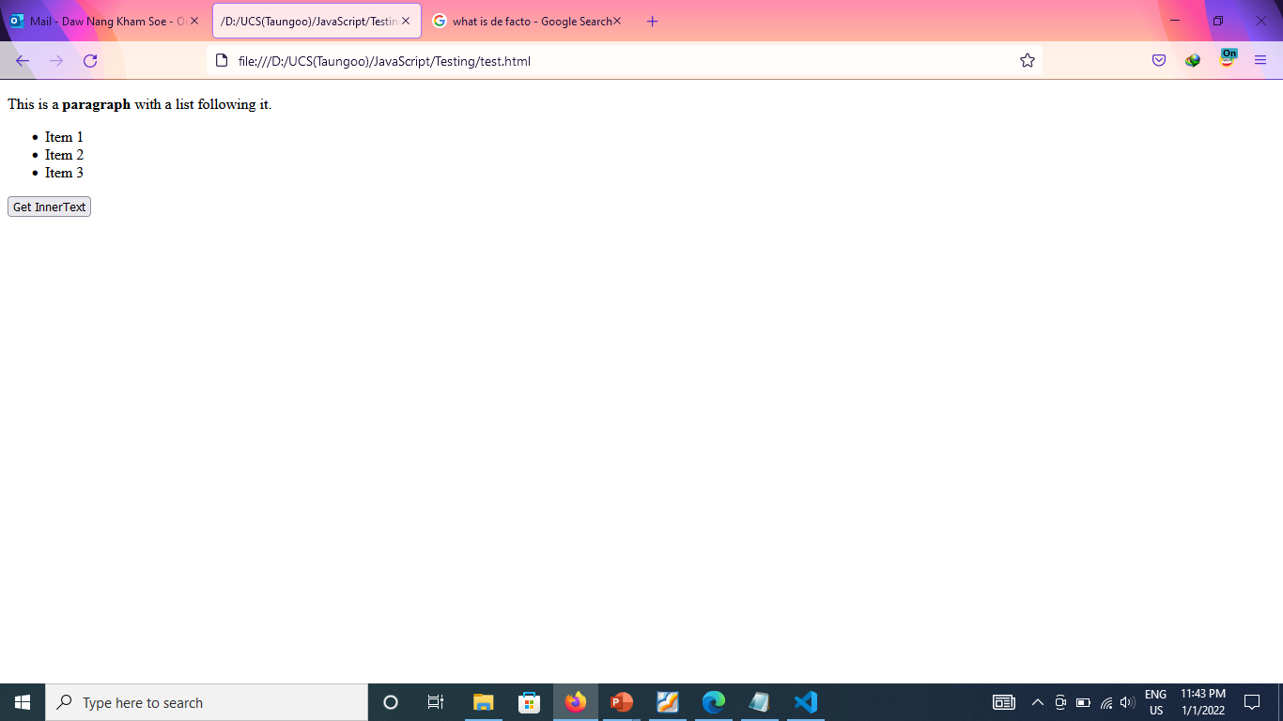
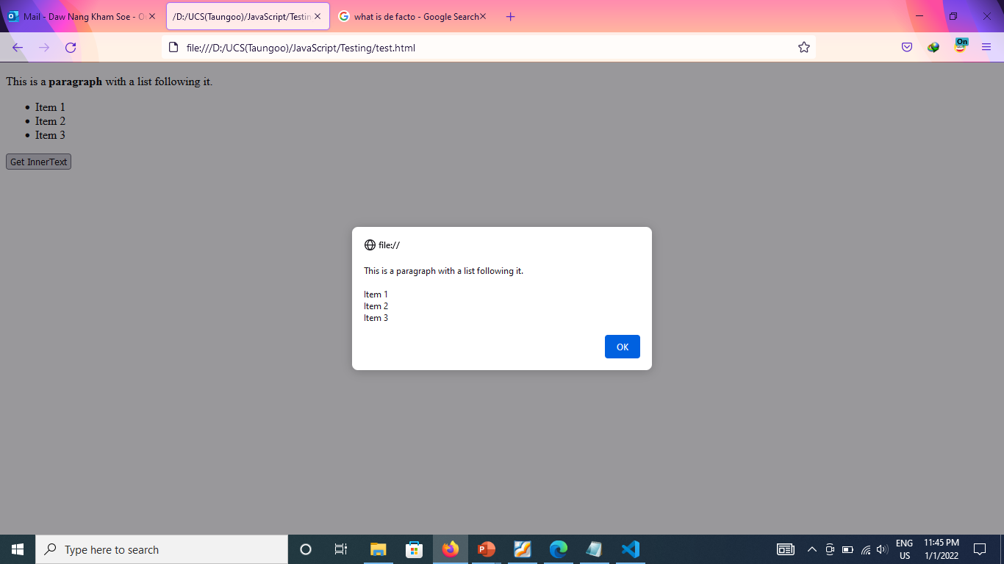
The innerText Property (2/4)
Information Technology Supporting and Maintenance

Slide 25
The innerText Property (3/4)
In write mode, the property removes all children of the element and inserts a text nodes containing the given value.
Example:
<body>
<div id="content">
<p>This is a <strong>paragraph</strong> with a list following it.</p>
<ul> <li>Item 1</li> <li>Item 2</li> <li>Item 3</li> </ul>
</div>
<input type="button" value="Set InnerText" onclick="setInnerText()">
<script type="text/javascript">
  function setInnerText(){
  var div = document.getElementById("content");
  div.innerText= "Hello <b> world!</b>";
  } </script> </body>
Information Technology Supporting and Maintenance

Slide 26
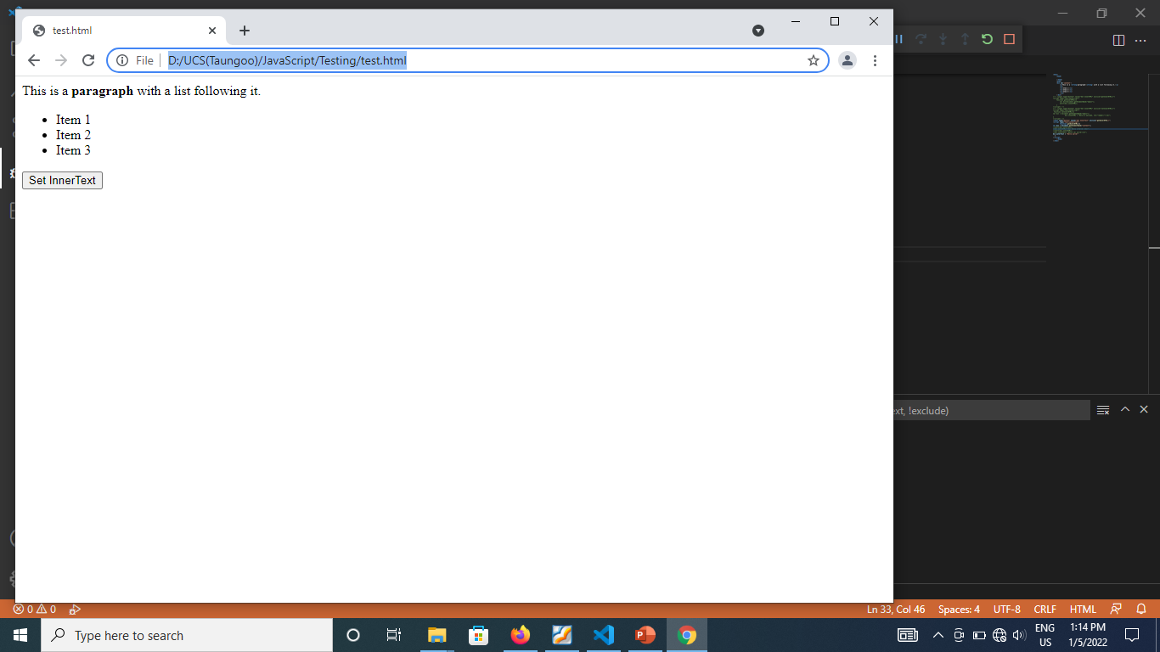

The innerText Property (4/4)
Information Technology Supporting and Maintenance

Slide 27
The outerText Property (1/3)
In read mode, the property behave in the exact same way as innerText property
Example:
  <body>
  <div id="content">
  <p>This is a <strong>paragraph</strong> with a list following it.</p>
  <ul>
  <li>Item 1</li><li>Item 2</li><li>Item 3</li>
  </ul></div>
  <input type="button" value="Get outerText" onclick="getOuterText()">
  <script type="text/javascript">
  function getOuterText(){
  var div = document.getElementById("content");
  alert(div.outerText); }
  </script></body>
Information Technology Supporting and Maintenance

Slide 28
The outerText Property (2/3)
In write mode, the property replaces the entire element, including its child nodes.
Example:
<body>
<div id="content">
<p>This is a <strong>paragraph</strong> with a list following it.</p>
<ul> <li>Item 1</li> <li>Item 2</li> <li>Item 3</li> </ul>
</div>
<input type="button" value="Set outerText" onclick=“setOuterText()">
<script type="text/javascript">
function setOuterText(){
    var div = document.getElementById("content");
    div.outerText = "Hello world!";}
</script> </body>
Information Technology Supporting and Maintenance

Slide 29
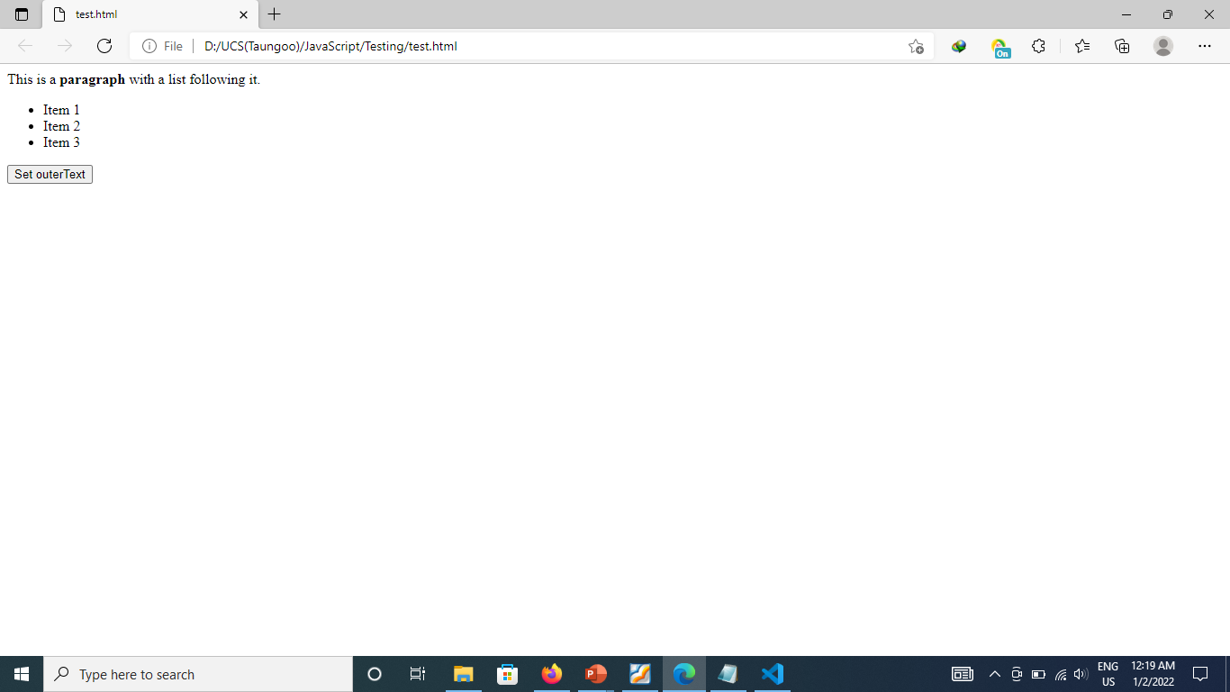
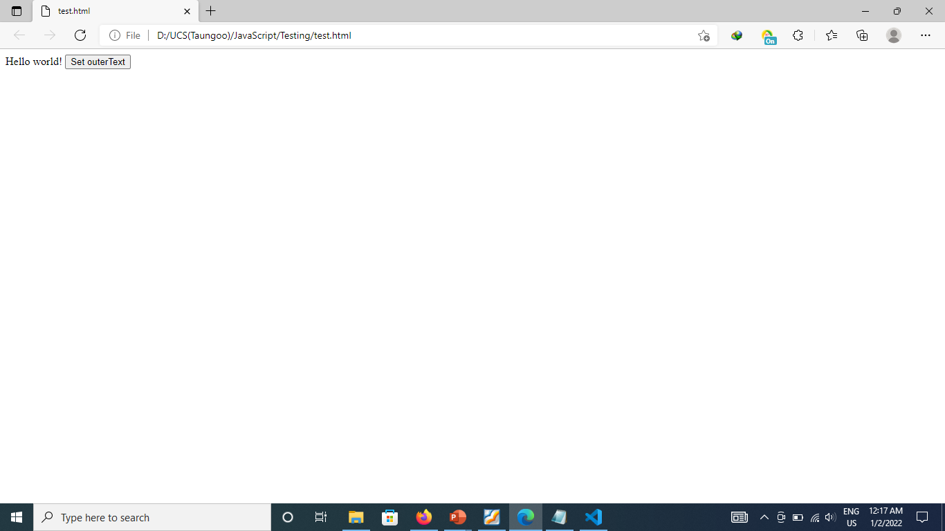
The outerText Property (3/3)
Information Technology Supporting and Maintenance

Slide 30
The insertAdjacentHTML() Method
inserts a text as HTML into a specified position.
accepts two arguments: (the position in which to insert, the HTML text to insert)
The ﬁrst argument must be one of the following values:
  “beforebegin”— Insert just before the element as a previous sibling.
  “afterbegin”— Insert just inside of the element as a new child or series of children before the first child.
  “beforeend”— Insert just inside of the element as a new child or series of children after the last child.
  “afterend”— Insert just after the element as a next sibling.
Information Technology Supporting and Maintenance

Slide 31
The insertAdjacentHTML() Method
//insert as previous sibling
element.insertAdjacentHTML(“beforebegin”, “<p>Hello world!</p>”);
//insert as first child
element.insertAdjacentHTML(“afterbegin”, “<p>Hello world!</p>”);
//insert as last child
element.insertAdjacentHTML(“beforeend”, “<p>Hello world!</p>”);
//insert as next sibling
element.insertAdjacentHTML(“afterend”, “<p>Hello world!</p>”);
Information Technology Supporting and Maintenance

Slide 32
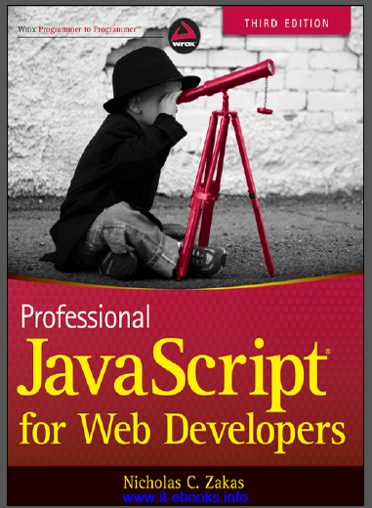
References
“PROFESSIONAL JavaScript for web Developers”
Third Edition
Zichalos C.Zakas
Nicholas, “Professional JavaScript for Web Development”
Colleen van Lent Ph.D, “INTERACTIVITY WITH JAVASCRIPT”
Information Technology Supporting and Maintenance

Slide 33
Thank You
1
Information Technology Supporting and Maintenance

